Slide 1
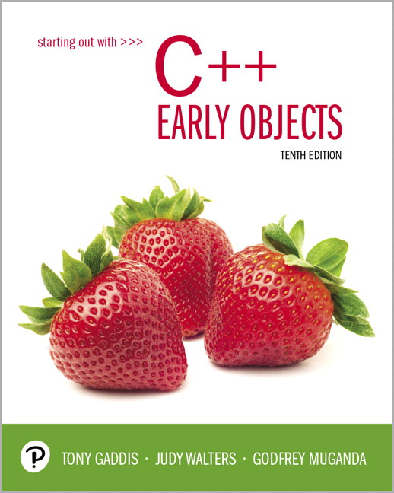
Starting Out with C++ Early Objects
Tenth Edition
Chapter 8
Arrays and Vectors

Slide 2
Topics 1 of 2
8.1 Arrays Hold Multiple Values
8.2 Accessing Array Elements
8.3 Inputting and Displaying Array Contents
8.4 Array Initialization
8.5 The Range-Based for loop
8.6 Processing Array Contents
8.7 Using Parallel Arrays

Slide 3
Topics 2 of 2
8.8 The typedef Statement
8.9 Arrays as Function Arguments
8.10 Two-Dimensional Arrays
8.11 Arrays with Three or More Dimensions
8.12 Introduction to the STL vector
8.13 Arrays of Objects

Slide 4
8.1 Arrays Hold Multiple Values
Array: a variable that can store multiple values of the same type
The values are stored in consecutive memory locations
It is declared using [] operator
const int ISIZE = 5;
int tests[ISIZE];

Slide 5
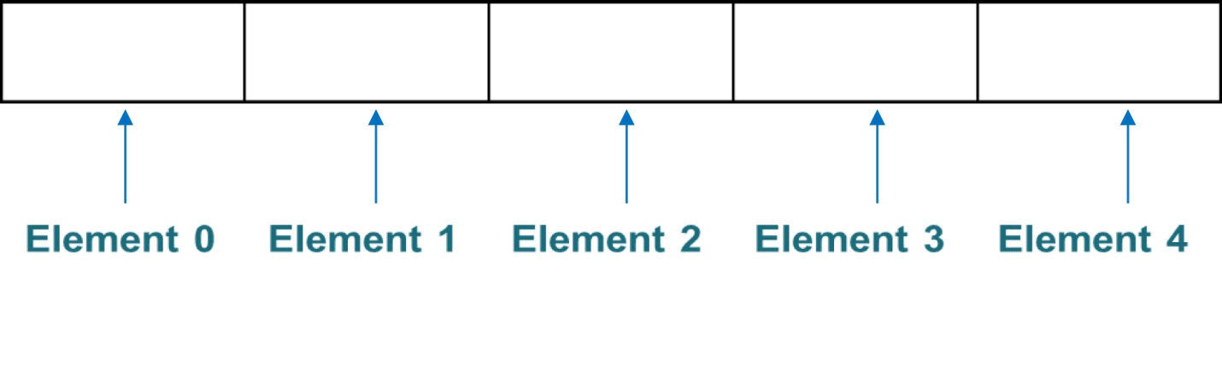
Array Storage in Memory
The definition
int tests[ISIZE]; // ISIZE is 5
allocates the following memory

Slide 6
Array Terminology
In the definition int tests[ISIZE];
int is the data type of the array elements
tests is the name of the array
ISIZE, in [ISIZE], is the size declarator. It shows the number of elements in the array.
The size of an array is the number of bytes allocated for it
(number of elements) * (bytes needed for each element)

Slide 7
Array Examples
Examples:
Assumes int uses 4 bytes and double uses 8 bytes
const int ISIZE = 5, DSIZE = 10;
int tests[ISIZE]; // holds 5 ints, array
// occupies 20 bytes
double volumes[DSIZE];// holds 10 doubles,
// array occupies
// 80 bytes

Slide 8
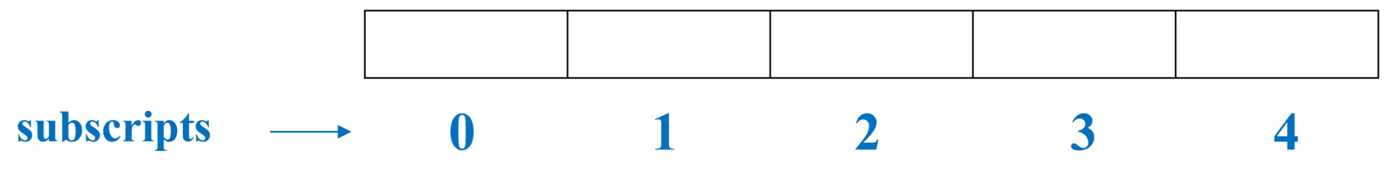
8.2 Accessing Array Elements 1 of 2
Each array element has a subscript, used to access the element.
Subscripts start at 0

Slide 9
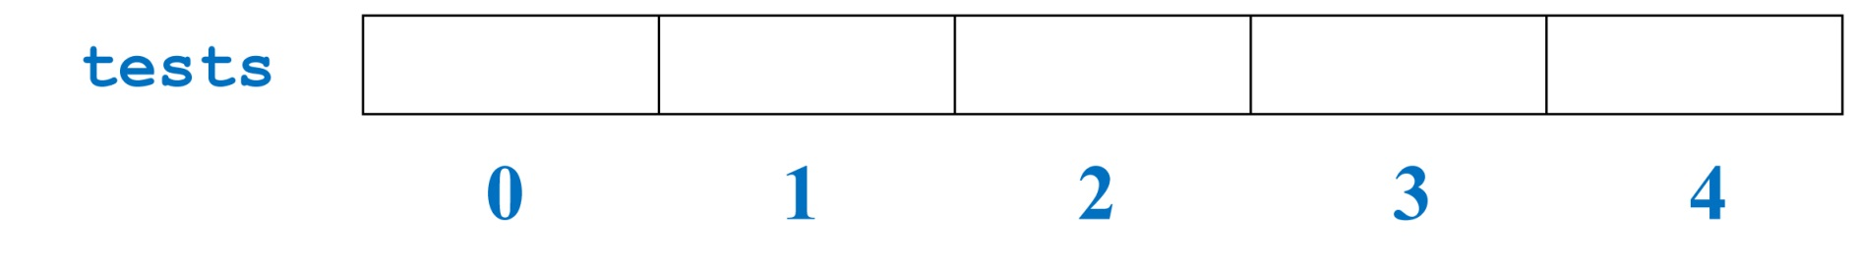
Accessing Array Elements 2 of 2
Array elements (accessed by array name and subscript) can be used as regular variables
tests[0] = 79;
cout << tests[0];
cin >> tests[1];
tests[4] = tests[0] + tests[1];
cout << tests; // illegal due to
// missing subscript

Slide 10
8.3 Inputting and Displaying Array Contents
cout and cin can be used to display values from and store values into an array
const int ISIZE = 5;
int tests[ISIZE]; // Define 5-elt. array
cout << "Enter first test score ";
cin >> tests[0];
Notes:
See pr8-01.cpp

Slide 11
Array Subscripts
Array subscript can be an integer constant, integer variable, or integer expression
Examples: Subscript is
cin >> tests[3]; int constant
cout << tests[i]; int variable
cout << tests[i+j]; int expression

Slide 12
Accessing All Array Elements
To access each element of an array
Use a loop
Use the loop control variable as the array subscript
A different array element will be referenced each time through the loop
for (i = 0; i < 5; i++)
cout << tests[i] << endl;
Notes:
See pr8-02.cpp

Slide 13
Getting Array Data from a File
const int ISIZE = 5;
int sales[ISIZE];
ifstream dataFile;
dataFile.open("sales.dat");
if (!dataFile)
cout << "Error opening data file\n";
else // Input daily sales
{ for (int day = 0; day < ISIZE; day++)
dataFile >> sales[day];
dataFile.close();
}
Notes:
See pr8-03.cpp

Slide 14
Sending Array Data to a File
Open the file using an ofstream object
Use a loop to write each array element to the file
Close the file

Slide 15
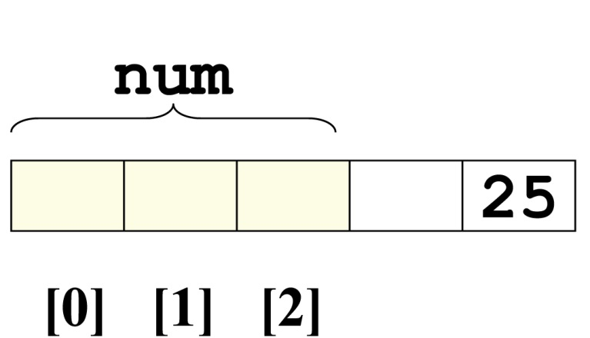
No Bounds Checking
There are no checks in C++ that an array subscript is in range
An invalid array subscript can cause the program to overwrite other memory
Example:
const int ISIZE = 3;
int i = 4;
int num[ISIZE];
num[i] = 25;
Notes:
See pr8-04.cpp

Slide 16
Off-By-One Errors
These most often occur when a program accesses data one position beyond the end of an array, or misses the first or last element of an array.
If an array has size n, then the range of the subscripts is from 0 to n-1

Slide 17
8.4 Array Initialization
An array can be initialized during program execution with assignment statements
tests[0] = 79;
tests[1] = 82; // etc.
It can be initialized at array definition with an initialization list
const int ISIZE = 5;
int tests[ISIZE] = {79,82,91,77,84};
Notes:
See pr8-05.cpp and pr8-06.cpp

Slide 18
Start at element 0 or 1?
You may choose to declare arrays to be one larger than needed. This allows you to use the element with subscript 1 as the ‘first’ element, etc., and may minimize off-by-one errors.
The element with subscript 0 is not used.
This is most often done when working with ordered data that logically begins with 1, e.g., months of the year or days of the week
Notes:
See pr8-05B.cpp and pr8-06B.cpp

Slide 19
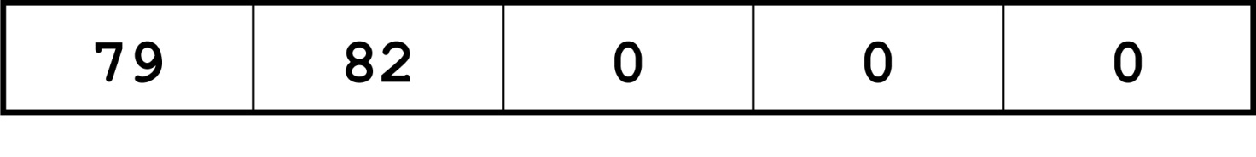
Partial Array Initialization
If array is initialized at definition with fewer values than the size declarator of the array, the remaining elements will be set to 0 or the empty string
int tests[ISIZE] = {79, 82};
Initial values are used in order; you cannot skip over elements to initialize a noncontiguous range
You cannot have more values in the initialization list than the declared size of the array
Notes:
See pr8-07.cpp

Slide 20
Implicit Array Sizing
C++ can determine the array size by the size of the initialization list
short quizzes[]={12,17,15,11};
You must use either an array size declarator or an initialization list when the array is defined

Slide 21
Alternate Ways to Initialize Variables
You can initialize a variable at definition time using a functional notation
int length(12); // same result as
// int length = 12;
In C++ 11 and higher, you can also do this:
int length{12};
The second approach checks the argument to ensure that it matches the data type of the variable, and will generate a compiler error if not

Slide 22
8.5 The Range-Based for Loop
Uses a variable that will hold a different array element for each iteration
Format:
for (data_type var : array)
statement;
data_type : the type of the variable
var: the variable
statement; : the loop body
Introduced in C++ 11

Slide 23
Range-Based for Loop - Details
data_type must be the type of the array elements, or a type that the array elements can be automatically converted to
var will hold the value of successive array elements as the loop iterates. Each array element is processed in the loop
statement; can be a single statement or a block of statements enclosed in { }

Slide 24
Range-Based for Loop – Example 1
// sum the elements of an array
int [] grades = {68,84,75};
int sum = 0;
for (int score : grades)
sum += score;
Notes:
See pr8-08.cpp and pr8.09.cpp

Slide 25
Range-Based for Loop – Example 2
// modify the contents of an array
const int ISIZE = 3;
int [ISIZE] grades;
for (int &score : grades)
{
cout << "Enter a score: ";
cin >> score;
}

Slide 26
Comparison: Range-Based for Loop vs. Regular for Loop
The range-based for loop provides a simple notation to use to process all of the elements of an array.
However, it does not give you access to the subscripts of the array elements.
If you need to know the element locations as well as the element values, then use a regular for loop.

Slide 27
8.6 Processing Array Contents
Array elements can be
treated as ordinary variables of the same type as the array
used in arithmetic operations, in relational expressions, etc.
Example:
if (principalAmt[3] >= 10000)
interest = principalAmt[3] * intRate1;
else
interest = principalAmt[3] * intRate2;
Notes:
See pr8-10.cpp

Slide 28
Using Increment and Decrement Operators with Array Elements
When using ++ and -- operators, don’t
confuse the element with the subscript
tests[i]++; // adds 1 to tests[i]
tests[i++]; // increments i, but has
// no effect on tests

Slide 29
Copying One Array to Another
You cannot copy with an assignment statement:
tests2 = tests; //won’t work
You must instead use a loop to copy element-by-element:
for (int indx=0; indx < ISIZE; indx++)
tests2[indx] = tests[indx];
Notes:
See arrayCopy.cpp

Slide 30
Are Two Arrays Equal?
Like copying, you cannot compare two arrays in a single expression:
if (tests2 == tests)
You can use a while loop with a bool variable:
bool areEqual=true;
int indx=0;
while (areEqual && indx < ISIZE)
{
if(tests[indx] != tests2[indx]
areEqual = false;
indx++;
}
Notes:
See arrayCompare.cpp

Slide 31
Find the Sum, Average of Array Elements
Use a simple loop to add together array elements
float average, sum = 0;
for (int tnum=0; tnum< ISIZE; tnum++)
sum += tests[tnum];
Or use C++ 11 range-based for loop:
for (int num : tests)
sum += num;
Once summed, average can be computed
average = sum/ISIZE;

Slide 32
Find the Largest Array Element
Use a loop to examine each element and find the largest element (i.e., one with the largest value)
int largest = tests[0];
for (int tnum = 1; tnum < ISIZE; tnum++)
{ if (tests[tnum] > largest)
largest = tests[tnum];
}
cout << "Highest score is " << largest;
A similar algorithm exists to find the smallest element
Notes:
See pr8-11.cpp

Slide 33
Using Arrays vs. Using Simple Variables
An array is probably not needed if the input data is only processed once:
Find the sum or average of a set of numbers
Find the largest or smallest of a set of values
If the input data must be processed more than once, an array is probably a good idea:
Calculate the average, then determine and display which values are above the average, at the average, and below the average

Slide 34
Partially-Filled Arrays
The exact amount of data (and, therefore, the array size) may not be known when a program is written.
The programmer makes a best estimate for the maximum amount of data, then sizes arrays accordingly. A sentinel value can be used to indicate end-of-data.
The programmer must also keep track of how many array elements are actually used
Notes:
See pr8-12.cpp

Slide 35
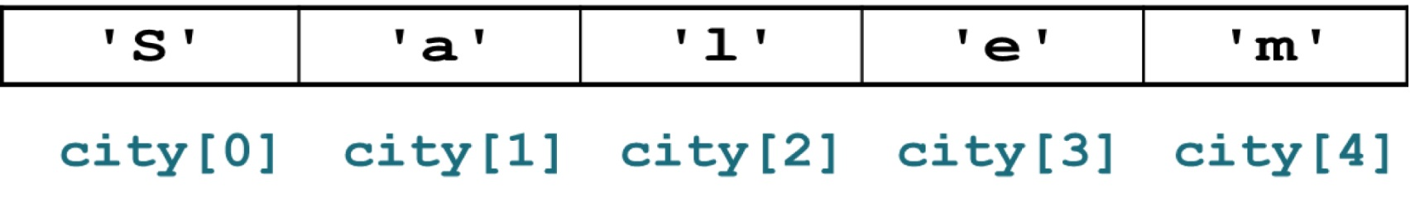
C-Strings and string Objects
They can be processed using the string name
Entire string at once, or
One element at a time by using a subscript
string city;
cout << "Enter city name: ";
cin >> city;
Notes:
See pr8-13.cpp and pr8-14.cpp

Slide 36
8.7 Using Parallel Arrays
Parallel arrays: two or more arrays that contain related data
The subscript is used to relate the arrays
elements at the same subscript are related
The arrays do not have to hold data of the same type

Slide 37
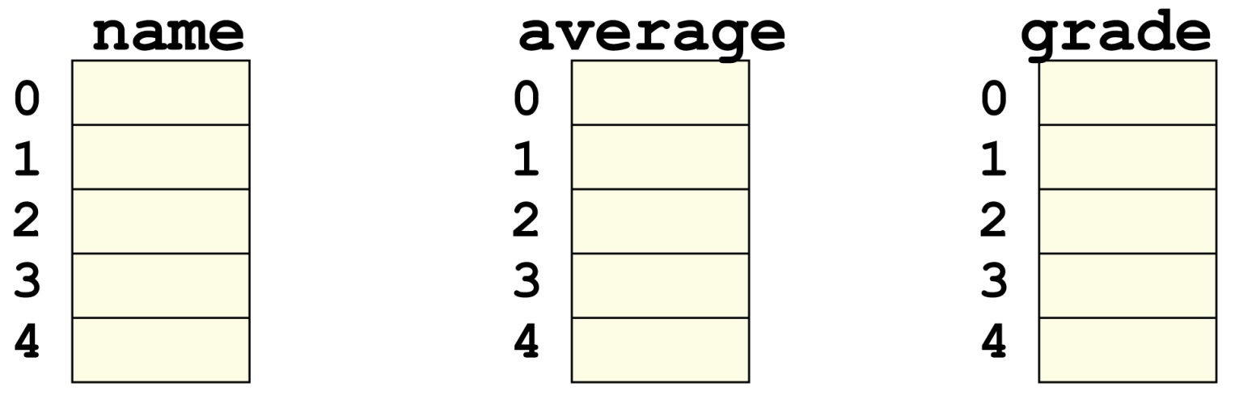
Parallel Array Example
const int ISIZE = 5;
string name[ISIZE]; // student name
float average[ISIZE]; // course average
char grade[ISIZE]; // course grade

Slide 38
Parallel Array Processing
const int ISIZE = 5;
string name[ISIZE]; // student name
float average[ISIZE]; // course average
char grade[ISIZE]; // course grade
...
for (int i = 0; i < ISIZE; i++)
cout << " Student: " << name[i]
<< " Average: " << average[i]
<< " Grade: " << grade[i]
<< endl;
Notes:
See pr8-15.cpp

Slide 39
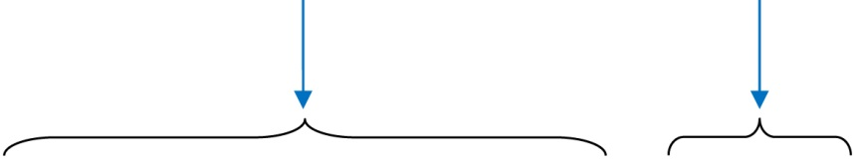
8.8 The typedef Statement
Creates an alias for a simple or structured data type
Format:
typedef existingType newName;
Example:
typedef unsigned int Uint;
Uint tests[ISIZE]; // array of
// unsigned ints

Slide 40
Uses of typedef
It can be used to make code more readable
Can be used to create an alias for an array of a particular type
// Define yearArray as a data type
// that is an array of 12 ints
typedef int yearArray[MONTHS];
// Create two of these arrays
yearArray highTemps, lowTemps;

Slide 41
8.9 Arrays as Function Arguments
Passing a single array element to a function is no different than passing a regular variable of that data type
The function does not need to know that the value it receives is coming from an array
displayValue(score[i]); // call
void displayValue(int item) // header
{ cout << item << endl;
}
Notes:
See pr8-16.cpp

Slide 42
Passing an Entire Array 1 of 2
To define a function that has an array parameter, use empty [] to indicate the array in the prototype and header
To pass an array to a function, just use the array name
// Function prototype
void showScores(int []);
// Function header
void showScores(int tests[])
// Function call
showScores(tests);

Slide 43
Passing an Entire Array 2 of 2
Use the array name, without any brackets, as the argument
You can also pass the array size as a separate parameter so the function knows how many elements to process
showScores(tests, 5); // call
void showScores(int[], int); // prototype
void showScores(int A[],int size) // header
Notes:
See pr8-17.cpp and pr8-19.cpp

Slide 44
Using typedef with a Passed Array
You can use typedef to simplify function prototype and header
// Make intArray an integer array
// of unspecified size
typedef int intArray[];
// Function prototype
void showScores(intArray, int);
// Function header
void showScores(intArray tests, int size)
Notes:
See pr8-18.cpp

Slide 45
Modifying Arrays in Functions
Array parameters in functions are similar to reference variables
Changes made to an array passed to a function are made to the actual array in the calling function
The programmer must be careful that an array is not inadvertently changed by a function
The const keyword can be used in the prototype and header to prevent changes
Notes:
See pr8-19.cpp and pr8-20.cpp

Slide 46
8.10 Two-Dimensional Arrays
You can define one array for multiple sets of data
It is like a table in a spreadsheet
Use two size declarators in definition
int exams[4][3];
// first [] is rows,
// second [] is columns

Slide 47
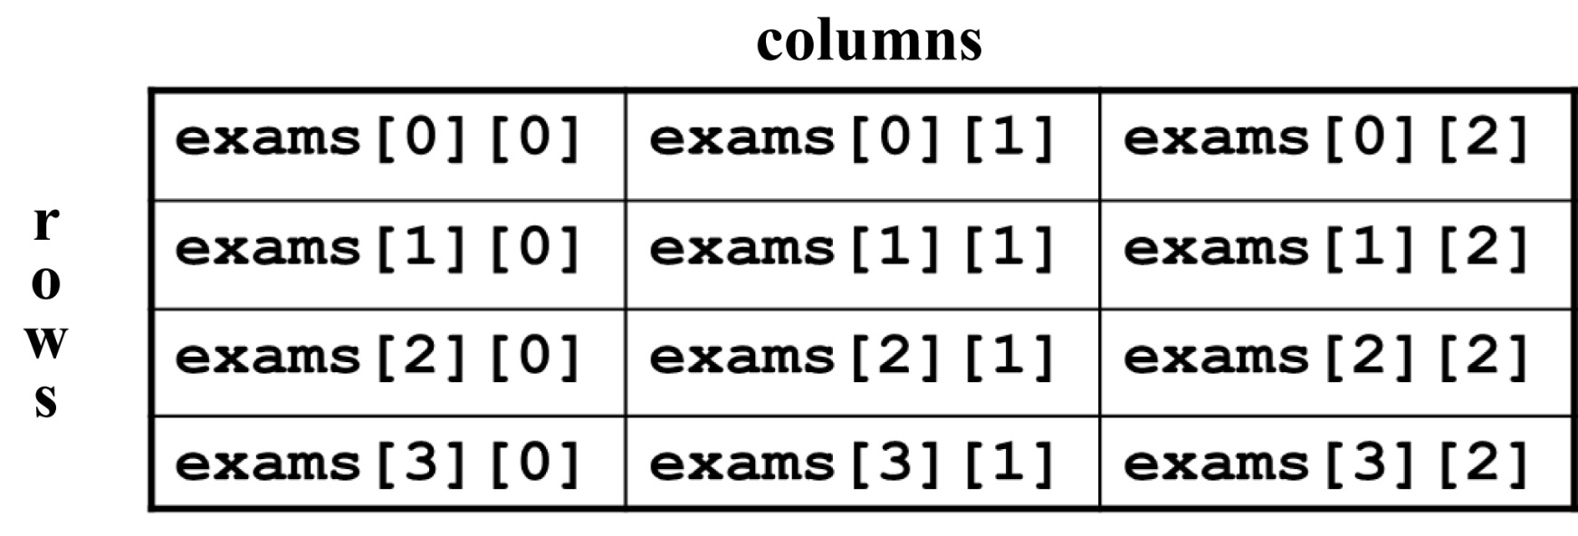
Two-Dimensional Array Representation
int exams[4][3];
Use two subscripts to access an element
exams[2][1] = 86;
Notes:
See pr8-21.cpp

Slide 48
Two-Dimensional Array Access
When you use access an element of a two-dimensional array
exams[2][1] = 86;
The first subscript, [2], indicates the row in the array
The second subscript, [1], indicates the column in the array

Slide 49
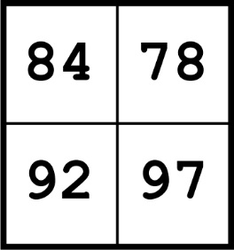
Initialization at Definition
Two-dimensional arrays are initialized row-by-row
int exams[2][2] = { {84, 78},
{92, 97} };
The inner { } in the initialization improve readability but are not required
The inner { } can be used to initialize some but not all elements of a two-dimensional array

Slide 50
Passing a Two-Dimensional Array to a Function
Use the array name and the number of columns as arguments in the function call
getExams(exams, 2);
Use empty [] for row and a size declarator for the number of columns in the prototype and header
// Prototype, where NUM_COLS is 2
void getExams(int[][NUM_COLS], int);
// Header
void getExams
(int exams[][NUM_COLS], int rows)
Notes:
See pr8-22.cpp

Slide 51
Using typedef with a Two-Dimensional Array
Can use typedef for simpler notation
typedef int intExams[][2];
...
// Function prototype
void getExams(intExams, int);
// Function header
void getExams(intExams exams, int rows)

Slide 52
Two-Dimensional Array Traversal
Use nested loops, one for the row and one for the column, to visit each array element.
Accumulators can be used to calculate the sum of the elements row-by-row, column-by-column, or over the entire array.

Slide 53
8.11 Arrays with Three or More Dimensions
You can define arrays that have any number of dimensions
short rectSolid [2][3][5];
double timeGrid [3][4][3][4];
When this type of array is used as a parameter, specify the size of all but the 1st dimension
void getRectSolid(short [][3][5]);
Notes:
See pr8-23.cpp

Slide 54
8.12 Introduction to the STL Vector
A vector holds a sequence of elements, like a one-dimensional array
Its size is flexible. It can grow and shrink
There is no need to specify the size when defined
Space is automatically added as needed
Defined in the Standard Template Library (STL)
See Chapter 17
Must include vector header file to use vectors
#include <vector>

Slide 55
Vectors
It can hold values of any data type, specified when the vector is defined
vector<int> scores;
vector<double> volumes;
You can specify initial size if desired
vector<int> scores(24);
You can use [] to access individual elements

Slide 56
Defining Vectors
Define a vector of integers (starts with 0 elements)
vector<int> scores;
Define int vector with initial size 30 elements
vector<int> scores(30);
Define 20-element int vector and initialize all elements to 0
vector<int> scores(20, 0);
Define int vector initialized to size and contents of vector finals
vector<int> scores(finals);
Notes:
See pr8-24.cpp

Slide 57
C++ 11 Features for Vectors
C++ 11 supports vector definitions that use an initialization list
vector<int> scores {88, 67, 79, 84};
Note: no = operator between the vector name and the initialization list
A range-based for loop can be used to access the elements of a vector
for (int test : scores)
cout << test << " ";
Notes:
See pr8-25.cpp

Slide 58
Growing a Vector’s Size
Use the push_back member function to add an element to a full vector or to a vector that had no defined size
// Add a new element holding the value 75
scores.push_back(75);
Use the size member function to determine the number of elements currently in a vector
int howbig = scores.size();
Notes:
See pr8-26.cpp and pr8-27.cpp

Slide 59
Removing Vector Elements
Use the pop_back member function to remove the last element from a vector
scores.pop_back();
Note: pop_back removes the last element but does not return it
To remove all of the elements from a vector, use the clear member function
scores.clear();
To determine if a vector is empty, use empty member function
while (!scores.empty()) ...
Notes:
See pr8-28.cpp, pr8-29.cpp, and pr8-30.cpp

Slide 60
8.13 Arrays of Objects 1 of 2
Objects can be used as array elements
class Square
{ private:
int side;
public:
Square(int s = 1)
{ side = s; }
int getSide()
{ return side; }
};
Square shapes[10]; // Create array of 10
// Square objects

Slide 61
Arrays of Objects 2 of 2
Use the array subscript to access a specific object in the array
Then use dot operator to access the member methods of that object
for (i = 0; i < 10; i++)
cout << shapes[i].getSide() << endl;
Notes:
See Circle.h and pr8-31.cpp

Slide 62
Initializing Arrays of Objects 1 of 2
You can use the default constructor to perform the same initialization for all objects
You can use an initialization list to supply specific initial values for each object
Square shapes[5] = {1,2,3,4,5};
The default constructor is used for the remaining objects if initialization list is too short
Square boxes[5] = {1,2,3};
Notes:
See Circle.h, pr8-31B.cpp, and pr8-32.cpp

Slide 63
Initializing Arrays of Objects 2 of 2
If an object is initialized with a constructor that takes > 1 argument, the initialization list must include a call to the constructor for that object
Rectangle spaces[3]={ Rectangle(2,5),
Rectangle(1,3),
Rectangle(7,7)
};
The same constructor does not have to be used for every object that is being initialized

Slide 64
Arrays of Structures 1 of 2
Structures can be used as array elements
struct Student
{
int studentID;
string name;
short year;
double gpa;
};
const int CSIZE = 30;
Student class[CSIZE]; // Holds 30
// Student structures
An array of structures can be used as an alternative to parallel arrays

Slide 65
Arrays of Structures 2 of 2
Use the array subscript to access a specific structure in the array
Then use the dot operator to access members of that structure
cin >> class[25].studentID;
cout << class[i].name << " has GPA "
<< class[i].gpa << endl;
Notes:
See pr8-33.cpp

Slide 66

Copyright

